Slide 1
Welcome!
Sunday
Worship 9:30 AM
Sunday
Bible Class (Livestream) 5:00 PM
Wednesday
Bible Class 7:00 PM
www.SunsetchurchofChrist.net

Slide 2
Opening Prayer | Anthony Ward
Song – | Craig Foster
Song – | Craig Foster
Lord’s Supper | Lamar McDonald
Song – | Craig Foster
Song – | Craig Foster
Lesson | Brian Haines
Song – | Craig Foster
Closing | Michael Hetzer
1 Corinthians 16:2
On the first day of the week let each one of you lay something aside, storing up as he may prosper, that there be no collections when I come.
The collection basket
is in the foyer

Slide 3
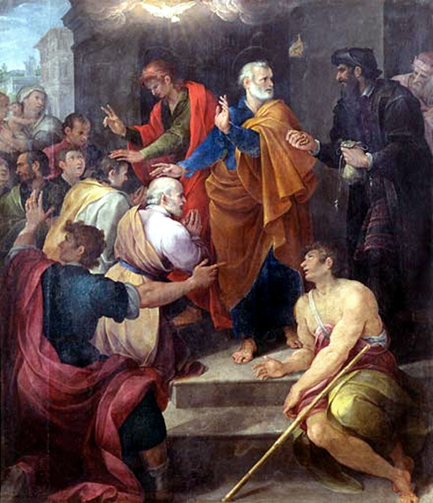
Simon’s Heart Acts 8:5-24

Slide 4
Who Was Simon?
Traditions of Men:
Simon Magus
Founder of Gnostic heresy
Enemy of the church
“Simony”: buying spiritual powers

Slide 5
Who Was Simon?
The Word of God
A Samaritan
A magician
Known as “The Great Power of God”
A disciple of Jesus Christ
A man who sinned greatly

Slide 6
Simon’s Sin
He thought God’s gifts could be purchased
- By money
- By things or actions

Slide 7
Simon’s Sin
He thought God’s gifts could be purchased
His heart was not right before God
Poisoned by bitterness – Hebrews 12:15
Bound by iniquity – Galatians 5:1
Notes:
Heb 12:15 looking carefully lest anyone fall short of the grace of God; lest any root of bitterness springing up cause trouble, and by this many become defiled;
Ga 5:1 ¶ Stand fast therefore in the liberty by which Christ has made us free, and do not be entangled again with a yoke of bondage.

Slide 8
Simon’s Response
It was not:
Denial of his heart situation
Accusation against the Apostles for:
Racism
Jealousy
Power hungry

Slide 9
Simon’s Response
Instead:
Simon accepted his fault
He asked for prayers of others – James 5:16
Simon is a lesson to us on being chastised
Notes:
Jas 5:16 Confess your trespasses to one another, and pray for one another, that you may be healed. The effective, fervent prayer of a righteous man avails much.

Slide 10
When Accused of Sin
The wrong responses
Anger
Accusation
Denial
Defensiveness
Notes:
Jas 5:16 Confess your trespasses to one another, and pray for one another, that you may be healed. The effective, fervent prayer of a righteous man avails much.

Slide 11
When Accused of Sin
The wrong responses
The right responses
Humility – 1 John 1:8/Romans 3:23
Self-examination – 2 Corinthians 13:5
Acceptance of error – 1 John 1:9-10
Notes:
1Jo 1:8 ¶ If we say that we have no sin, we deceive ourselves, and the truth is not in us.
2Co 13:5 Examine yourselves as to whether you are in the faith. Test yourselves. Do you not know yourselves, that Jesus Christ is in you? --unless indeed you are disqualified.
1Jo 1:9 If we confess our sins, He is faithful and just to forgive us our sins and to cleanse us from all unrighteousness. 10 If we say that we have not sinned, we make Him a liar, and His word is not in us.

Slide 12
When Accused of Offense
The wrong responses
Lashing out
Being offended
Notes:
Jas 5:16 Confess your trespasses to one another, and pray for one another, that you may be healed. The effective, fervent prayer of a righteous man avails much.

Slide 13
When Accused of Offense
The wrong responses
The right response
Determining the offense – Matthew 11:6
Dealing with offense – Matthew 5:23-24
Notes:
Mt 11:6 "And blessed is he who is not offended because of Me.“
Mt 5:23 "Therefore if you bring your gift to the altar, and there remember that your brother has something against you, 24 "leave your gift there before the altar, and go your way. First be reconciled to your brother, and then come and offer your gift.

Slide 14
When Advice is Given
The wrong responses
Damaged ego
Resentful
Beligerance

Slide 15
When Advice is Given
The wrong responses
The right response
A love of truth – 2 Thessalonians 2:10
A love of one another – 1 Peter 1:22
Believing the best – 1 Corinthians 13:7
Notes:
2Th 2:10 and with all unrighteous deception among those who perish, because they did not receive the love of the truth, that they might be saved.
1Pe 1:22 Since you have purified your souls in obeying the truth through the Spirit in sincere love of the brethren, love one another fervently with a pure heart,
1Co 13:7 bears all things, believes all things, hopes all things, endures all things.

Slide 16
When Warnings are Made
The wrong responses
Ignoring
Self-justification
Vanity

Slide 17
When Warnings are Made
The wrong responses
The right response
Awareness of our failings – Jeremiah 10:23
Appreciating good advice – Proverbs 27:6
Notes:
Jer 10:23 O LORD, I know the way of man is not in himself; It is not in man who walks to direct his own steps.
Pr 27:6 Faithful are the wounds of a friend, But deceitful are the kisses of an enemy.

Slide 18
A Lesson from Simon
Simon’s errors are serious
He had lost his salvation!
Simon’s response is worth noting
He was neither offended nor defensive
His desire was to be corrected

Slide 20
Simon’s Salvation
Then Simon himself also believed; and when he was baptized he continued….. Acts 8:13
"He who believes and is baptized will be saved” Mark 16:16

Slide 21
Simon’s Salvation
Then Simon himself also believed; and when he was baptized he continued….. Acts 8:13
"He who endures to the end
shall be saved.” Matthew 24:13

